Slide 1
UDS Services 0x10, 0x11, 0x28 and 0x3E

Slide 2

Diagnostic Session Control (0x10) service
The DiagnosticSessionControl service is used to enable different diagnostic sessions in the server.
A diagnostic session enables a specific set of diagnostic services and/or functionality in the server.
There shall always be exactly one diagnostic session active in a server. A server shall always start the default diagnostic session when powered up. If no other diagnostic session is started, then the default diagnostic session shall be running as long as the server is powered.
A server shall be capable of providing diagnostic functionality under normal operating conditions and in other operation conditions defined by the vehicle manufacturer.
If the client has requested a diagnostic session, which is already running, then the server shall send a positive response message and behave as shown in the next slide.

Slide 3
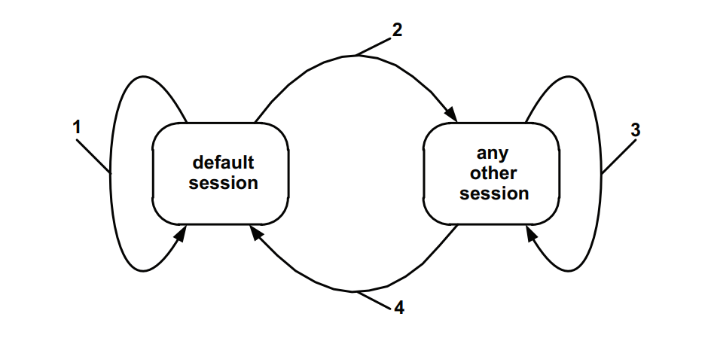
Diagnostic Session Control (0x10) service
Whenever the client requests a new diagnostic session, the server shall send the DiagnosticSessionControl positive response message before the timings of the new session become active in the server.
If the server is not able to start the requested new diagnostic session, then it shall respond with a DiagnosticSessionControl negative response message and the current session shall continue.

Slide 4
Diagnostic Session Transitions
default session: When the server is in the defaultSession and the client requests to start the defaultSession then the server shall re-initialize the defaultSession completely. The server shall reset all activated/initiated/changed settings/controls during the activated session. This does not include long term changes programmed into non-volatile memory.
other session: When the server transitions from the defaultSession to any other session than the defaultSession then the server shall only stop the events (similar to stopResponseOnEvent) that have been configured in the server via the ResponseOnEvent (0x86) service during the defaultSession.
same or other session: When the server transitions from any diagnostic session other than the defaultSession to another session other than the defaultSession (including the currently active diagnostic session) then the server shall (re-) initialize the diagnostic session, which means that:
Each event that has been configured in the server via the ResponseOnEvent (0x86) service shall be stopped.
Security shall be relocked. Note that the locking of security access shall reset any active diagnostic functionality that was dependent on security access to be unlocked (e.g., active inputOutputControl of a DID).
All other active diagnostic functionality that is supported in the new session and is not dependent upon security access shall be maintained.
Notes:
Point 3, point iii) For example, states of communication control and controlDTCSettting services will not be affected. Which means, if any communication is disabled by the communication control, it will stay disabled when the sessions are switched.

Slide 5
default session: When the server transitions from any diagnostic session other than the default session to the defaultSession then the server shall stop each event that has been configured in the server via the ResponseOnEvent (0x86) service and security shall be enabled. Any other active diagnostic functionality that is not supported in the defaultSession shall be terminated.
Notes:
For example, (point 4). Any configured states of the communication control and control DTC Setting services will be reset. Which means that normal communication shall be re enabled if they were disabled before the switch back to the default session. This does not include long term changes programmed in to non volatile memory.

Slide 6
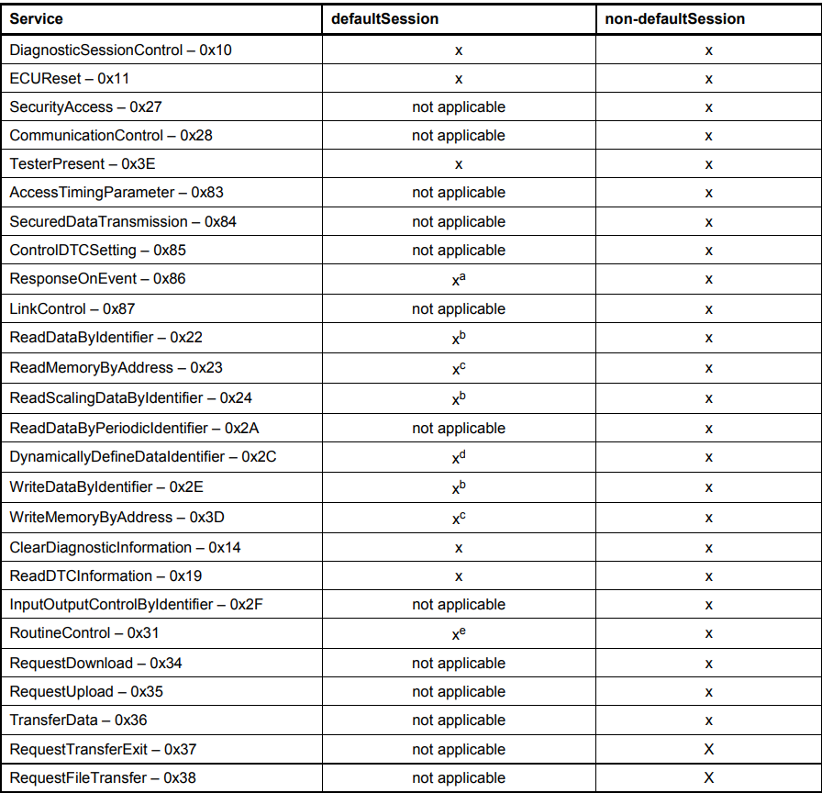
Services allowed during default and non default sessions
Notes:
A – it is implementation specific if ROE is allowed during default session.
B – Secure DIDs require security access service and therefore a non default session.
C – Secured memory areas require a Security Access services and therefore a non-default diagnostic session.
D – A DID can be defined dynamically in the default and non-default session.
E – Secured routines require a security access service and therefore a non-default diagnostic session. A routine that requires to be stopped actively also requires a non-default session.

Slide 7
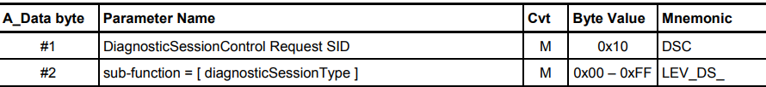
Request message definition

Slide 8
Sub-function parameter $Level definition
0x01 – Default Session: This diagnostic session enables the default diagnostic session in the server(s) and does not support any diagnostic application timeout handling provisions.
0x02 – Programming Session: This diagnosticSession enables all diagnostic services required to support the memory programming of a server.
0x03 – Extended Diagnostic Session: This diagnosticSession can be used to enable all diagnostic services required to support the adjustment of functions like "Idle Speed, CO Value, etc." in the server's memory. It can also be used to enable diagnostic services, which are not specifically tied to the adjustment of functions.
0x04 – Safety System Diagnostic Session: This diagnosticSession enables all diagnostic services required to support safety system related functions (e.g., airbag deployment).
0x05 – 0x3F ISOSAEReserved
0x40 – 0x5F Vehicle Manufacturer Specific: This range of values is reserved for vehicle manufacturer specific use.
0x60 – 0x7E System Supplier Specific: This range of values is reserved for system supplier specific use.
0x7F ISOSAEReserved
Notes:
Default session – no tester present service is necessary to keep the session active.
Programming session – in case the server runs the programming session in the boot software, the programming session shall onlt be left via an ECUReset (0x11), or by the DiagnosticSessionControl (0x10) service with service Type being the default Session.

Slide 9
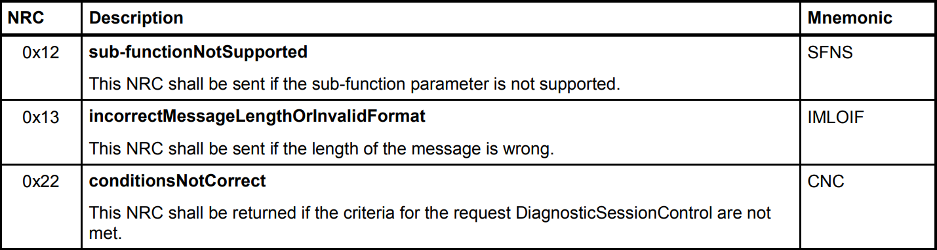
Supported Negative Response Codes

Slide 10
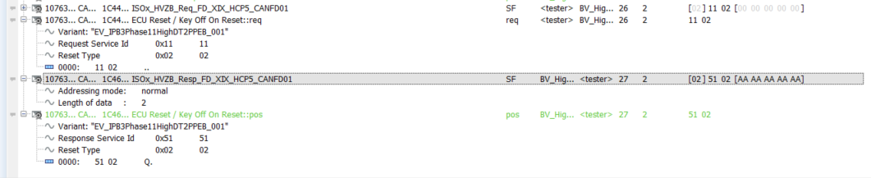
ECU Reset (0x11) Service
The ECUReset service is used by the client to request a server reset.
This service requests the server to effectively perform a server reset based on the content of the resetType parameter value embedded in the ECUReset request message.
The ECUReset positive response message (if required) shall be sent before the reset is executed in the server(s). After a successful server reset the server shall activate the defaultSession.

Slide 11
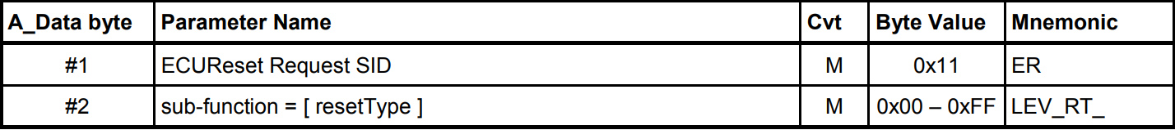
Request Message

Slide 12
Request message sub-function Parameter $Level definition
0x01 – Hard Reset: This value identifies a "hard reset" condition which simulates the power-on / start-up sequence typically performed after a server has been previously disconnected from its power supply. The performed action is implementation specific and not defined by the standard. It might result in the re-initialization of both volatile memory and non-volatile memory locations to predetermined values.
0x02 – Key Off On Reset: This value identifies a condition similar to the driver turning the ignition key off and back on. This reset condition should simulate a key-off-on sequence (i.e. interrupting the switched power supply). The performed action is implementation specific and not defined by the standard. Typically the values of non-volatile memory locations are preserved; volatile memory will be initialized.
0x03 – Soft Reset: This value identifies a "soft reset" condition, which causes the server to immediately restart the application program if applicable. A typical action is to restart the application without reinitializing of previously learned configuration data, adaptive factors and other long-term adjustments.
0x04 – Enable Rapid Power Shut Down: This subfunction applies to ECUs which are not ignition powered but battery powered only. Therefore a shutdown forces the sleep mode rather than a power off. Sleep means power off but still ready for wake-up (battery powered). The intention of the subfunction is to reduce the stand-by time of an ECU after ignition is turned into the off position.
Notes:
Enable Rapid Power Shut Down: The server shall execute the function immediately once the "key/ignition” is switched off. While the server executes the power down function, it shall transition either directly or after a defined stand-by-time to sleep mode. If the client requires a response message and the server is already prepared to execute the "rapid power shut down" function, the server shall send the positive response message prior to the start of the "rapid power shut down" function. The next occurrence of a "key on" or "ignition on" signal terminates the "rapid power shut down" function.

Slide 13
0x05 Disable Rapid Power Shut Down: This value requests the server to disable the previously enabled "rapid power shut down" function.
0x06 – 0x3F ISOSAEReserved
0x40 – 0x5F Vehicle Manufacturer Specific: This range of values is reserved for vehicle manufacturer’s specific use.
0x60 – 0x7E System Supplier Specific: This range of values is reserved for system supplier specific use.
0x7F ISOSAEReserved

Slide 14
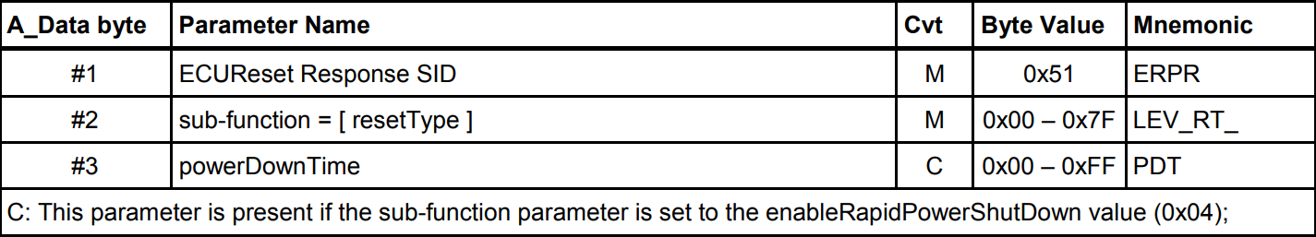
Positive Response Message
resetType: This parameter is an echo of bits 6-0 of the sub function parameter from the request message.
powerDownTime: This parameter indicates to the client the minimum time of the stand-by-sequence the server will remain in power down sequence.
The follwing values are valid:
0x00 – 0xFE: 0 – 254 seconds powerDownTime,
0xFF: indicates a failure or time not available

Slide 15
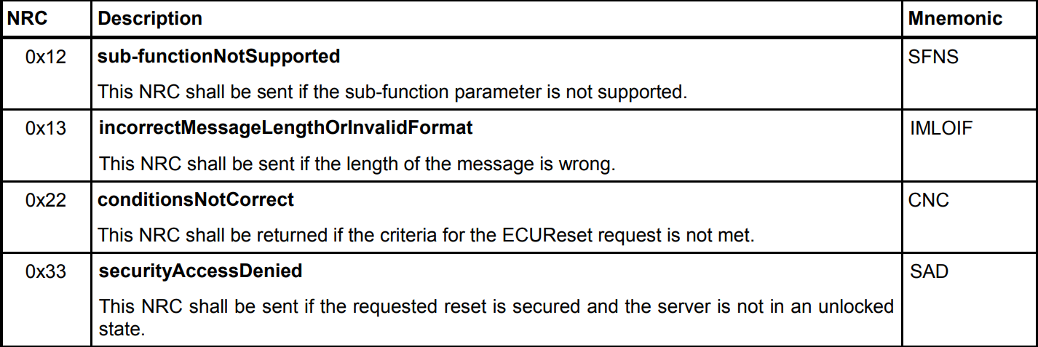
Supported Negative Response Codes

Slide 16
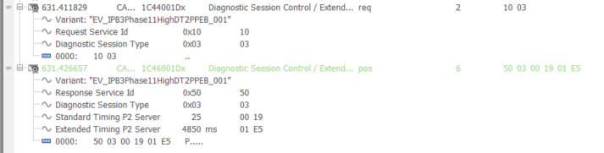
Tester Present (0x3E) service
This service is used to indicate to a server (or servers) that a client is still connected to the vehicle and that certain diagnostic services and/or communication that have been previously activated are to remain active.
This service is used to keep one or multiple servers in a diagnostic session other than the default Session.
This can either be done by transmitting the TesterPresent request message periodically or in case of the absence of other diagnostic services to prevent the server(s) from automatically returning to the default Session.

Slide 17
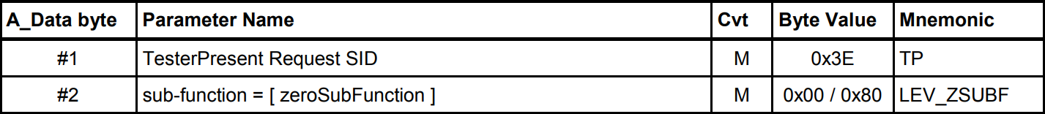
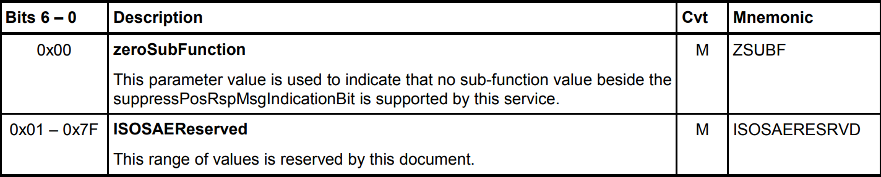
Request message definition

Slide 18
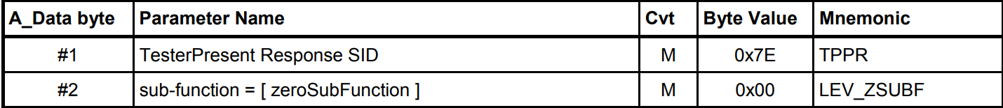
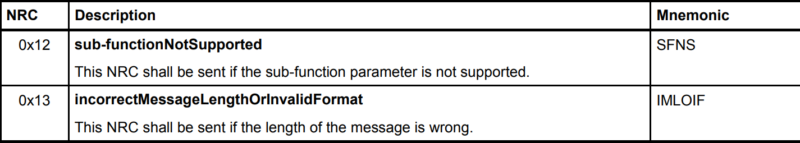
Positive Response Message Definition
Supported Negative Response Codes
Notes:
Zero Sub Function: This parameter is an echo of bits 6-0 of the sub function parameter from the request message.

Slide 19
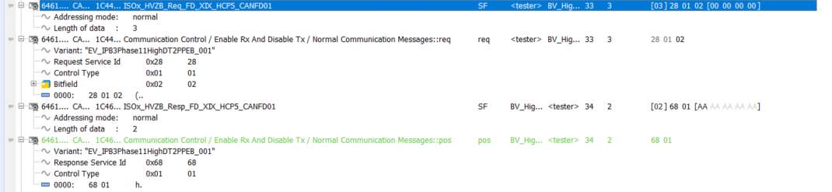
Communication Control (0x28) Service
The purpose of this service is to switch on/off the transmission and/or the reception of certain messages of (a) server(s) (e.g. application communication messages).

Slide 20
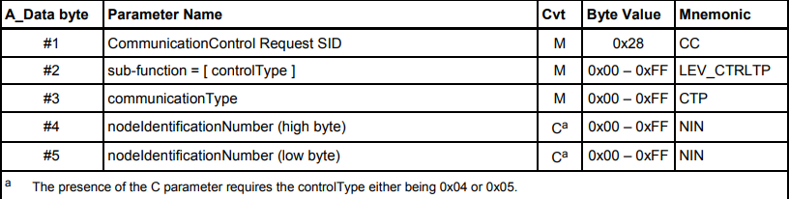
Notes:
Parameter C requires control type to be either ‘enableRxAndDisableTxWithEnhancedAddressInformation’ or ‘enableRxAndTxWithEnhancedAddressInformation’

Slide 21
Request Message sub-function definition
0x00 enableRxandTx: This value indicates that the reception and transmission of messages shall be enabled for the specified communicationType.
0x01 enableRxandDisableTx: This value indicates that the reception of messages shall be enabled and the transmission shall be disabled for the specified communicationType.
0x02 disableRxandEnableTx: This value indicates that the reception of messages shall be disabled and the transmission shall be enabled for the specified communicationType.
0x03 disableRxandTx: This value indicates that the reception and transmission of messages shall be disabled for the specified communicationType.
0x04 enableRxAndDisableTxWithEnhancedAddressInformation: This value indicates that the addressed bus master shall switch the related sub-bus segment to the diagnostic-only scheduling mode.
0x05 enableRxAndTxWithEnhancedAddressInformation: This value indicates that the addressed bus master shall switch the related sub-bus segment to the application scheduling mode.
0x06 – 0x3F – ISOSAEReserved
0x40 – 0x5F – VehicleManufacturerSpecific
0x60 – 0x7E - systemSupplierSpecific

Slide 22
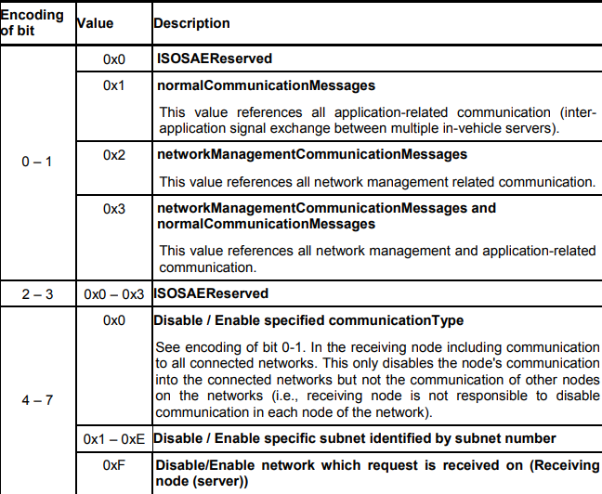
Communication Type Parameter
This parameter is used to reference the kind of communication to be controlled. The communicationType parameter is a bit-code value, which allows controlling multiple communication types at the same time.

Slide 23

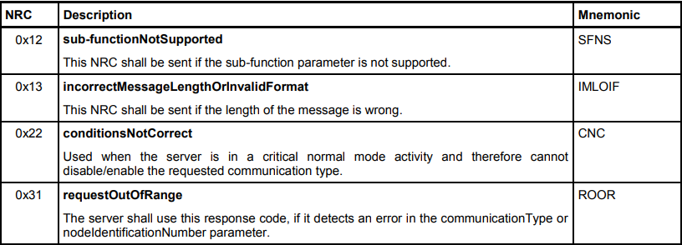
Supported Negative Response Codes
Positive Response Message

Slide 24
Further Resources
CAN TP ISO 15765: https://www.youtube.com/watch?v=hSoLFaI4-qg
ISO 14229 UDS:
https://desoeap16.delta.corp/svn/IPB_PPE_auto_porsche/trunk/20_Design/23_Software/2310_HowTo/HowTo_Diagnostics/ISO_14229-1_2013-03.pdf
TechnicalReference_Dcm.pdf
https://desoeap16.delta.corp/svn/External_IPB_auto_pag/trunk/20_Design/23_Software/2304_Implementation/10_APPL/10_ComController/1001_Common/70_Tools/10_AR_ToolChain/Components/Dcm/Documentation/TechnicalReference_Dcm.pdf

Slide 25
Smarter. Greener. Together.

